Slide 1
Project title : Hospital management system name : Govind singh Shekhawat submission date : 15 / 10 / 2024

Slide 2
Aim of the project :-
----> The primary objective of a Hospital Management System (HMS) is to improve the quality and efficiency of healthcare services by automating and streamlining hospital operations. Here are the main objectives and what you aim to achieve through its implementation:
Developing a centralized system for managing hospital operations.
Efficiently handling patient records, doctor schedules, and appointment management.
Utilizing object-oriented programming (OOP) principles for modularity and scalability.
Enhancing the patient satisfaction

Slide 3

business PROBLEM
Hospitals often face challenges in managing their day-to-day operations due to inefficient, manual processes. This includes handling patient records, scheduling appointments, managing billing and insurance claims, coordinating between departments, and ensuring compliance with healthcare regulations. These issues lead to delays, errors, and miscommunication, which negatively impact both the quality of patient care and the hospital's operational efficiency.
The HMS is intended to solve these problems by providing an integrated, automated system to streamline hospital operations, improve patient care, enhance communication, and ensure compliance with regulatory standards.

Slide 4

Project description :-
This project involves developing a Hospital Management System using Python's object-oriented programming (OOP) principles to structure the system’s core functionalities. Exception handling mechanisms are integrated to ensure reliability, especially when managing doctor and patient data or scheduling appointments. The following key functionalities are included :-
1. Patient Registration and Management.
2. Doctor Profile Management.
3. Appointment Scheduling.
4. Billing and Payment Integration (optional future enhancement).
5. Error Handling for invalid or missing data.

Slide 5
Functionalities :-
Patient Management
Doctor management
Appointment Scheduling
Error Handling with Custom Exceptions

Slide 6
Functionalities briefing :-
Patient management : This enables administrators to create and maintain patient profiles, track appointments, and healthcare records. It also supports error handling to ensure accurate record-keeping.
Doctor management: This feature allows for creating and managing doctor profiles, including ID, name, and specialization. It enables administrators to assign doctors to departments and keep their schedules updated in real time.
Appointment scheduling: This module automates the process of booking appointments between patients and doctors. It ensures that patients are assigned to the correct doctor based on their medical needs and the doctor’s specialization.
Error handling: DoctorNotFoundError or PatientNotFoundError when a doctor or patient cannot be found during appointment scheduling. These custom exceptions help the system manage errors without crashing and provide clear guidance to the user.

Slide 7
Input Versatility with Error Handling and Exception Handling :-
The system supports versatile input handling, including patient / doctor information entry, as well as appointment scheduling. Error handling is built-in to validate input data and ensure smooth operations. For example, the system checks for existing doctor or patient IDs before processing appointments and raises custom exceptions to prompt users to correct any errors.
This approach maintains data integrity and prevents critical mistakes that could affect hospital operations, ensuring system reliability and resilience.

Slide 8
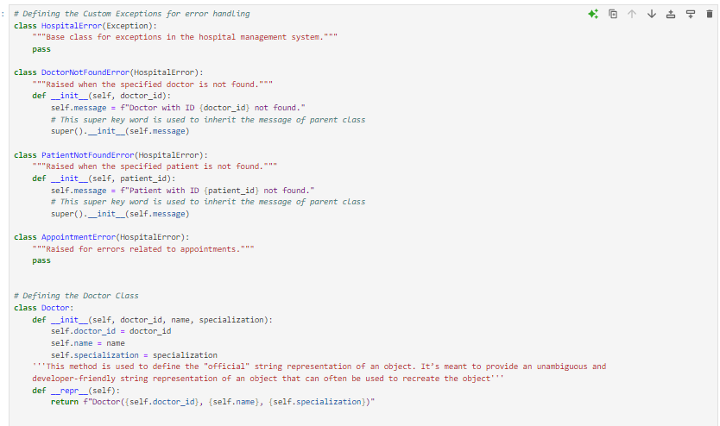

Code implementation :-

Slide 9
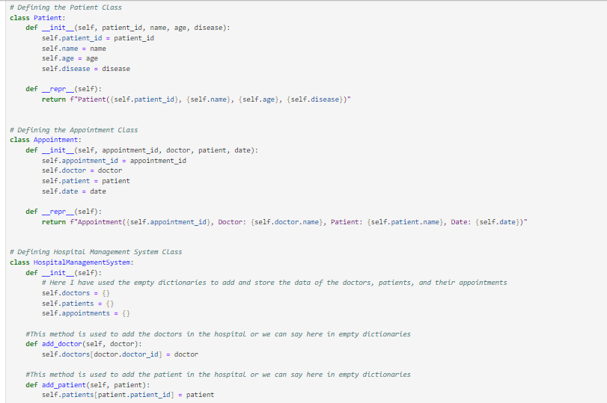

Code continues :-

Slide 10
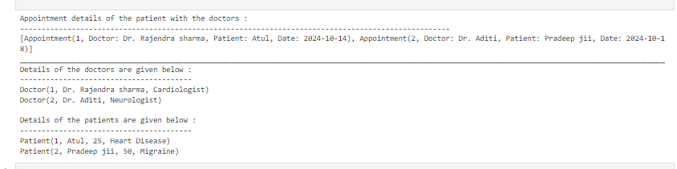
Result and outcomes

Slide 11
Conclusion :-
The Hospital Management System provides a comprehensive solution for healthcare institutions. It leverages OOP principles and robust error handling for efficiency, scalability, and data integrity. Its modular design allows for future enhancements, making it a valuable tool for modernizing hospital operations and improving patient care.

Slide 12
Thank you
Govind Singh Shekhawat
9116589460
govindshekhawat446@gmail.com

